Slide 1
FED ECONOMIC DATA ANALYSIS
Under the supervision of professor Srikanth Krishnamurthy
Team 6:
Puneeth Kumar (https://www.linkedin.com/in/puneethkumarreddy/)
Yamini Sehrawat (linkedin.com/in/yamini-sehrawat-1a26a197)
Vaidehi Deshpande (linkedin.com/in/vaidehid)

Slide 2
Dataset Description
Dataset Description
Link: https://www.richmondfed.org/research/regional_economy/reports/regional_profiles#tab-2
Description:
This dataset contains time series data for all economic indicators and states listed below:
States:
- District of Columbia
- Maryland
- North Carolina
- South Carolina
- Virginia
- West Virginia
2. Economic Indicators:
- GDP
- House Price Index
- Unemployment Rate
- Total Personal Income
The data is available in yearly format from 1977 till 2015 for all the indicators.

Slide 3
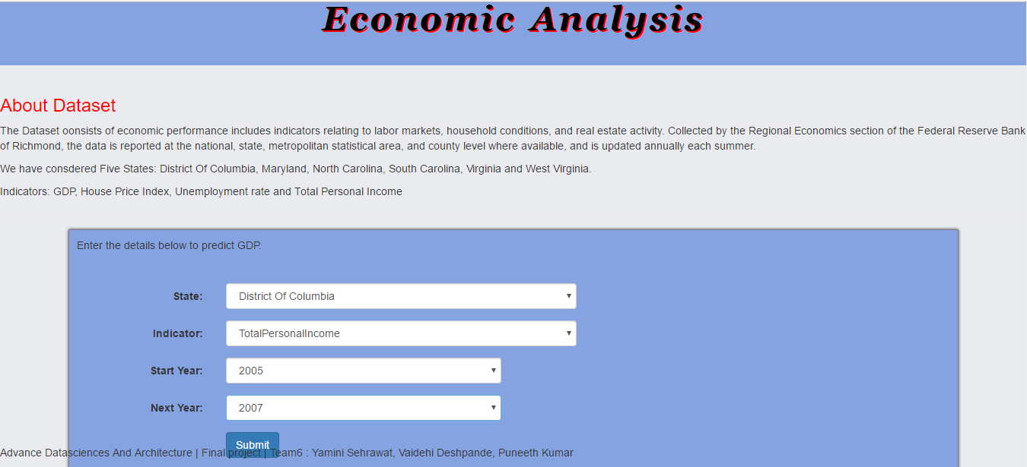
Web App Page 1

Slide 4
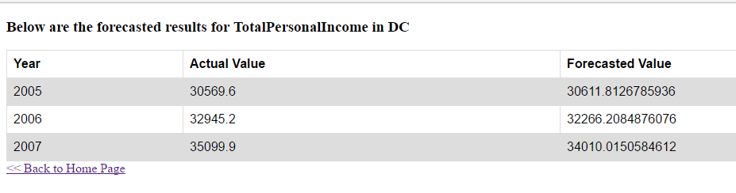
Web App Page 2

Slide 5
Types of time series data modeling
Following are the ways based on which we can build regression models on time series data:
Univariate : The future values of variable depends on its previous values
Multivariate: The values of dependent variable depend on its previous values as well as values of other variables in the dataset
Here we have restricted our analysis to univariate analysis but built a base for multivariate analysis.

Slide 6
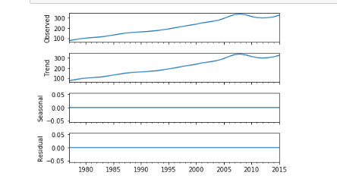
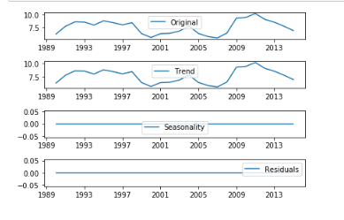
Decomposition of Time Series
Definition: The decomposition of time series is a statistical method that deconstructs a time series into several components, each representing one of the underlying categories of patterns.
We have decomposed all the time series based on rates of change.
Following are the components into which a time series is decomposed:
1. Trend: A trend exists when there is an increasing or decreasing direction in the data
2. Cyclical: describes repeated but non-periodic fluctuations
3. Seasonal: A seasonal pattern exists when a time series is influenced by seasonal factors
4. Noise: describes random, irregular influences; represents the residuals or remainder of the time series
Our time series decomposition examples:

Slide 7
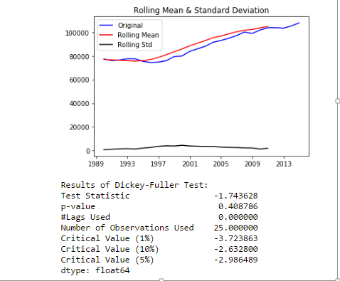
Stationarity Check
Time series data varies over a period of time and is not stationary (constant).
Hence, it may become difficult to build perfect models and predict values using such type of data.
As a result, we can perform following techniques to stationarize the data:
Log transformation
Differencing
Log + Differencing
We can check if the time series is stationary from following techniques:
Constant Mean and Variance
Test statistic of Dickey-Fuller test
Below is our original data graph which also contains mean and variance metrics alognwith the adfuller test results:

Slide 8
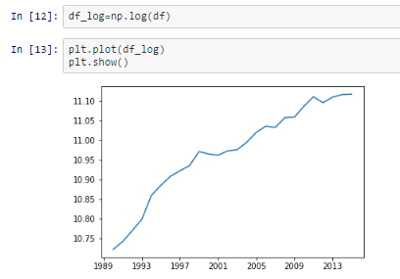
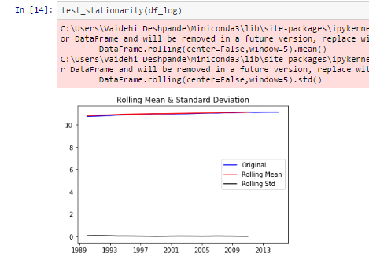
Stationarity Check Contd…
Since our original data is clearly not stationary, we have taken log transformation and again validated by plotting mean and variance:
As per above graphs it is clear that the mean and variance are almost constant over a period of time which implies that our time series is now stationary.
We can now go ahead and build models using the log transformed time series
Once the models are built and values are predicted we can boost the result to original scale by using numpy.exp() function

Slide 9
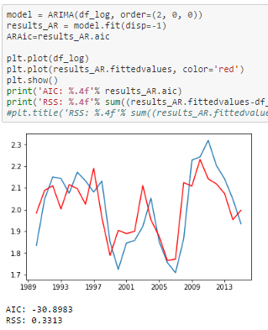
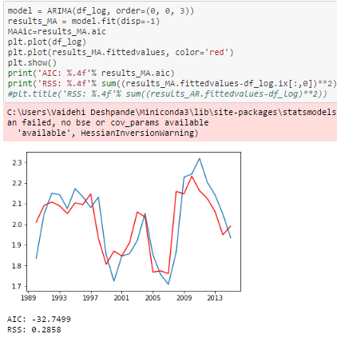
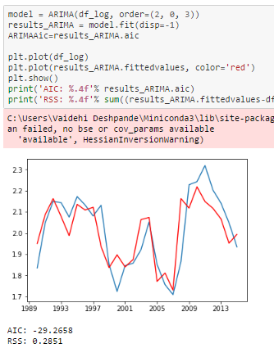
Building AR, MA and ARMA models
An autoregressive model is when a value from a time series is regressed on previous values from that same time series.
In addition to AR, we also have Moving Average (MA) models and a combination of both ARMA and ARIMA models. The predictors depend on the parameters (p,d,q) of the ARIMA model:
Number of AR (Auto-Regressive) terms (p): AR terms are just lags of dependent variable. For instance if p is 5, the predictors for x(t) will be x(t-1)….x(t-5).
Number of MA (Moving Average) terms (q): MA terms are lagged forecast errors in prediction equation. For instance if q is 5, the predictors for x(t) will be e(t-1)….e(t-5) where e(i) is the difference between the moving average at ith instant and actual value.
Number of Differences (d): These are the number of nonseasonal differences, i.e. in case we take the first order difference we can pass the differenced variable and put d=0 or pass the original variable and put d=1. Both will generate same results
Examples of models created:

Slide 10
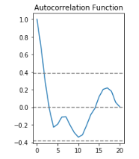
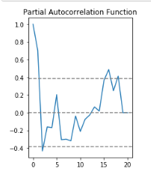
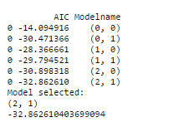
AIC, ACF and PACF
AIC:
Definition: The Akaike information criterion (AIC) is a measure of the relative quality of statistical models for a given set of data. Given a collection of models for the data, AIC estimates the quality of each model, relative to each of the other models.
Hence, AIC provides a means for best model selection. The lower the AIC better is the model
Here we have created a matrix containing model values and AIC measure and then have chosen the best model based which has lowest AIC value.
Autocorrelation Function (ACF):
Definition: It is a measure of the correlation between the TS with a lagged version of itself. For instance at lag 5, ACF would compare series at time instant ‘t1’…’t2’ with series at instant ‘t1-5’…’t2-5’ (t1-5 and t2 being end points).
Partial Autocorrelation Function (PACF):
Definition: This measures the correlation between the TS with a lagged version of itself but after eliminating the variations already explained by the intervening comparisons. Eg at lag 5, it will check the correlation but remove the effects already explained by lags 1 to 4.
Below are screenshots of AIC matrix, ACF and PAF plots as an example:

Slide 11
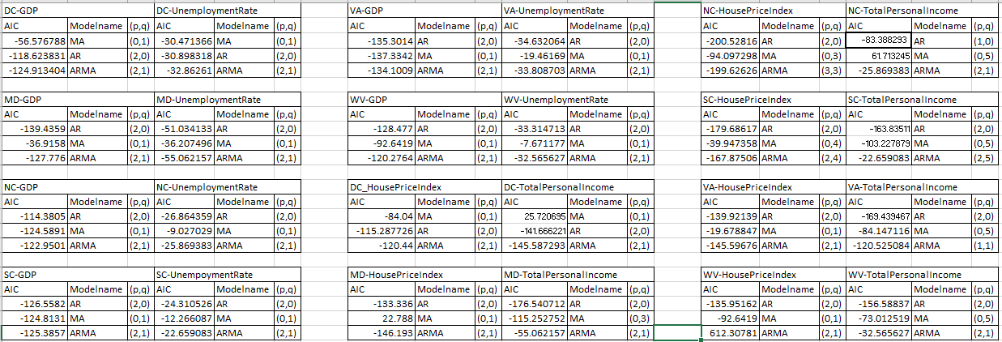
Summary Metrics

Slide 12
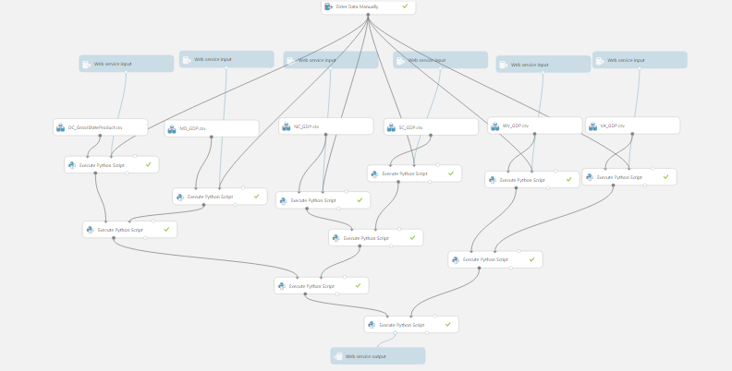
Azure Model
After choosing the best model we have deployed it in further in azure machine learning studio
We have created one model for each indicator and then created REST API for that
Below is the sample model created in azure:

Slide 13
Luigi Pipeline Tasks
We have created a Luigi pipeline which will perform following tasks automatically:
Data Download
This task programmatically scrapes the data from the website and saves to the local path
Transform data
Data downloaded in above task is available in row format, in this step we transform and clean the data and bring it in desired column format
3. Handle Missing Data
In this case, we almost had all data available except for one year data for Personal Income for West Virginia. In that case we have used the back fill method to impute the missing values.
4. Log Transformation
In order to make Time Series stationary, we are taking log transformations of original data frame in this Luigi task.
5. Generate AR, MA and ARMA models
After making time series stationary, the model creation task will be triggered which will build all types (AR, MA, ARMA) models for each time series and then choose the best model out of them depending on AIC. This will be done for each time series hence at the end we will have the best model for each economic indicator.
6. Predict and Forecast values
Once the best model is chosen, using it generate forecast for a entered number of years ahead. Also predict the existing values and save both the outputs in csv files on S3

Slide 14
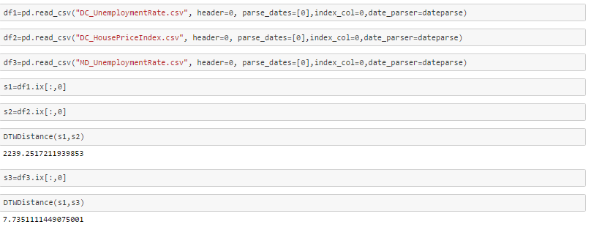
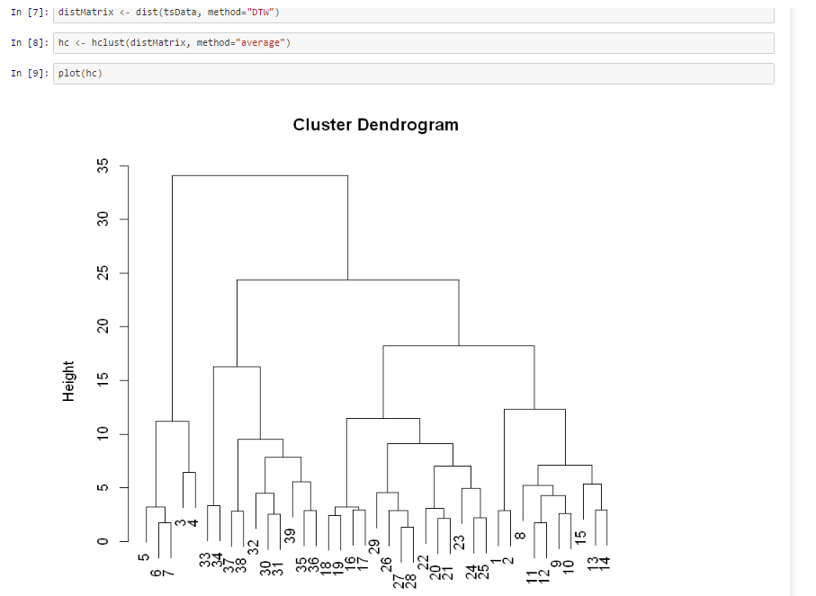
Clustering
Since we have time series data of varying lengths, we cannot apply the normal techniques of calculating Euclidean distance between data points and clustering based on k-means algorithm.
There is a special technique called Dynamic Time Warping (DTW) available for calculating the similarity between different time series.
We have implemented this function further to calculate distance measures between time series data we have here.
Going ahead we have used the Hierarchical Clustering technique for grouping together similar time series data

Slide 15
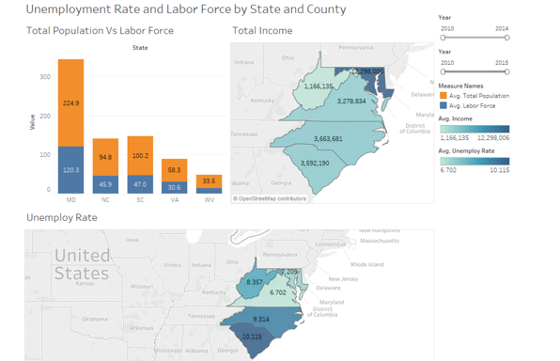
Exploratory Data Analysis
Compare different states based on Total Population, Labor Force, Unemployment Rate and Total Personal Income:

Slide 16
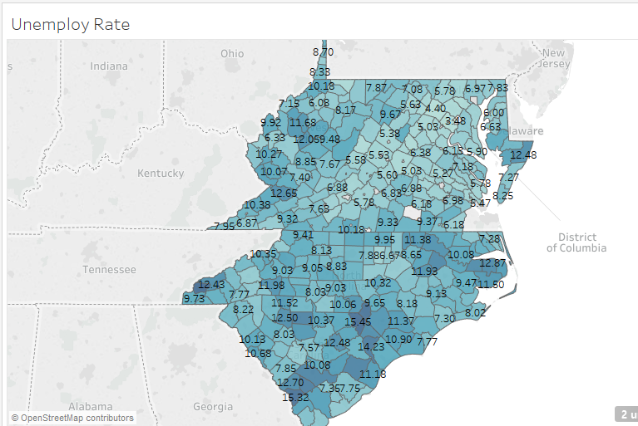
Exploratory Data Analysis
Compare different counties of states based on Unemployment Rate

Slide 17
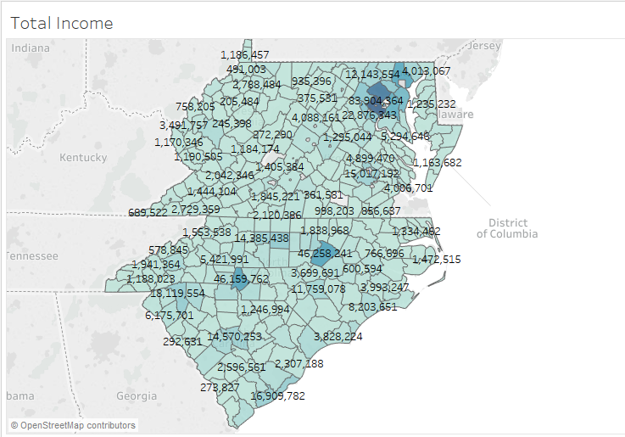
Exploratory Data Analysis
Compare different counties of states based on Total Personal Income

Slide 18
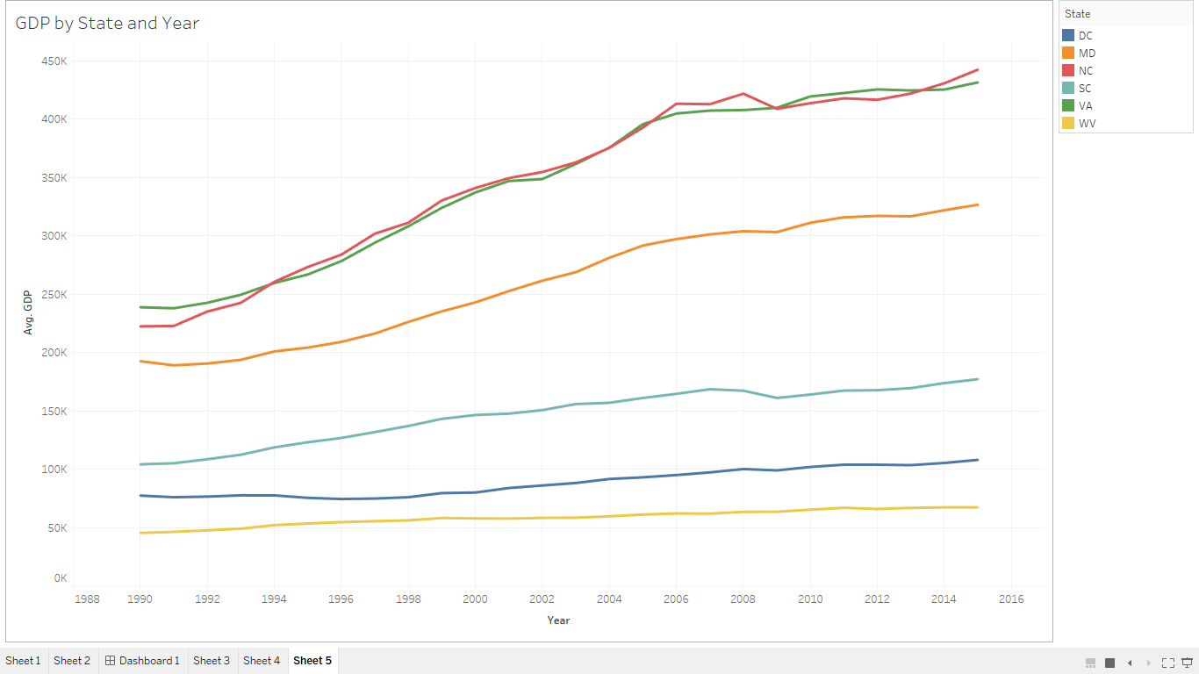
Exploratory Data Analysis Contd..
Compare trends in GDP for all states:

Slide 19
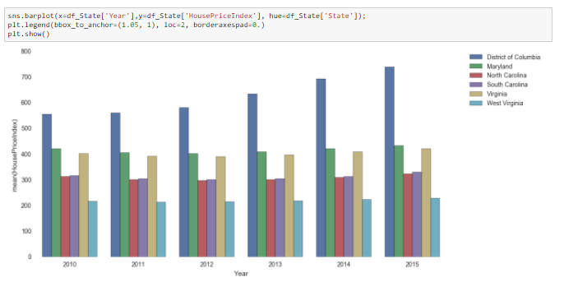
Exploratory Data Analysis Contd..
Compare states and metro areas for trends in House Price Index
a) Comparison of all states:

Slide 20
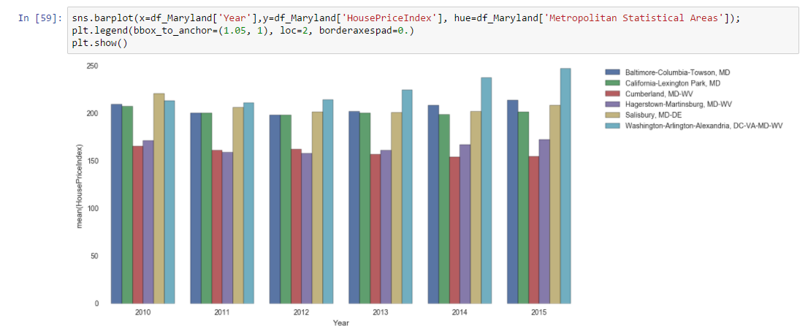
Exploratory Data Analysis Contd..
Compare states and metro areas for trends in House Price Index
b) Comparison of metro areas in Maryland:

Slide 21
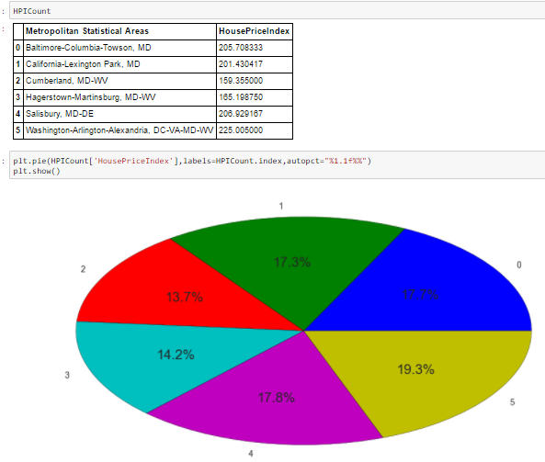
Exploratory Data Analysis Contd..
Compare states and metro areas for trends in House Price Index
c) Percentage contribution of metro areas in HPI of Maryland

Slide 22



Individual Contribution
Tasks done by Puneeth:
Download data , transform and clean data
Upload data files to S3 using Luigi pipeline
Building Azure models for all states and indicators
Deploy models and generate REST API
Create web application and deploy it on cloud
Tasks done by Yamini:
Univariate Time series Models using ARMA and ARIMA for Indicators: HousePriceIndex and TotalPersonalIncome for all six states in Python Jupyter notebook. Then tuned the Models
Performed Model Tuning and determine best model
Update Files preprocessing and Build models methods in Luigi script.
Front end for Web app.
Dockerized the tasks and uploaded the output files to Amazon S3
Tasks done by Vaidehi:
Summarizations in Tableau and Python
Untuned univariate models for GDP and Unemployment Rate
Tuned models with ARIMA and ARMA for GDP and Unemployment Rate in python Jupyter notebook
Clustering
Documentation

Slide 23
Pie Chart

Slide 24
THANK YOU!!

